Slide 1

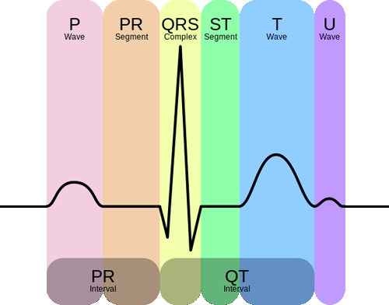


Minor Project EC6C06 A Secure IoT-based Heart Monitoring System
Under the guidance of
Sharmila B S
Assistant Professor, Dept. of Electronics and Communication
NIE, Mysuru
Anjani Kumar Srivastava –
Bhargavi R –
Nitesh Raj –
P Uttam –
4NI19EC015
4NI19EC123
4NI19EC063
4NI19EC064

Slide 2
Introduction
The rapid advancement in smart object technology has included significant achievements in application development for wireless sensor-based distributed communication architecture.
Capitalizing on the contactlessness and efficiency of data retrieval from modern smart objects, various innovative types of on-demand and real-time services have been developed and deployed in daily life.
The protection of data security and entity privacy are the most critical aspects of IoT-based healthcare systems. As the communication of the BSN is mostly wireless (and insecure) in nature, various attacks may be launched at it as a vulnerability entry, resulting in serious system damage to the entire system.

Slide 3
Problem Statement
Consider the scenario: There is a doctor and patient in one room. The patient's heart rate is sensed and output is obtained (from the first device + Arduino) in this room.
The value has to be sent to a second device in another room. In the other room, there is another doctor. His device receives the data and pushes that data into a file.
Thus the reports are transmitted wirelessly from one device to another device. The output is used to display an ECG graph.
In this project, we have built a secure heart monitoring system in which the heart rate of an individual is measured, and the data is sent to another device through sockets.

Slide 4
Literature survey
There are three indispensable components in the IoT-based communication architecture: the wearable body bio-sensors (i.e., the smart objects, in this case, the ECG sensor module), the Local Processing Unit (LPU) (here the data processing is done as per the instructions given by us), and the Body Sensor Networks (BSN) server.
The IoT-based biomedical equipment (i.e., body bio-sensors) is adopted (or embedded) by the user for collecting bio-data from the human. All the collected data will be forwarded to the server for data analysis and user-oriented service provision. That is, based on specific bio-data from the user, the system can recognize and satisfy the individual’s needs in a faster and more efficient way.
For instance, by analyzing human bio-data, such as electrocardiography (ECG), electroencephalography (EEG), electromyography (EMG), and blood pressure (BP), a healthcare system in a hospital can provide more individually-tailored and timely services and reduce delays in medical treatment.

Slide 5
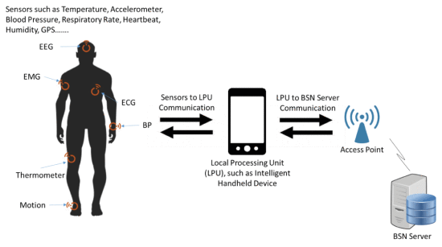

Slide 6
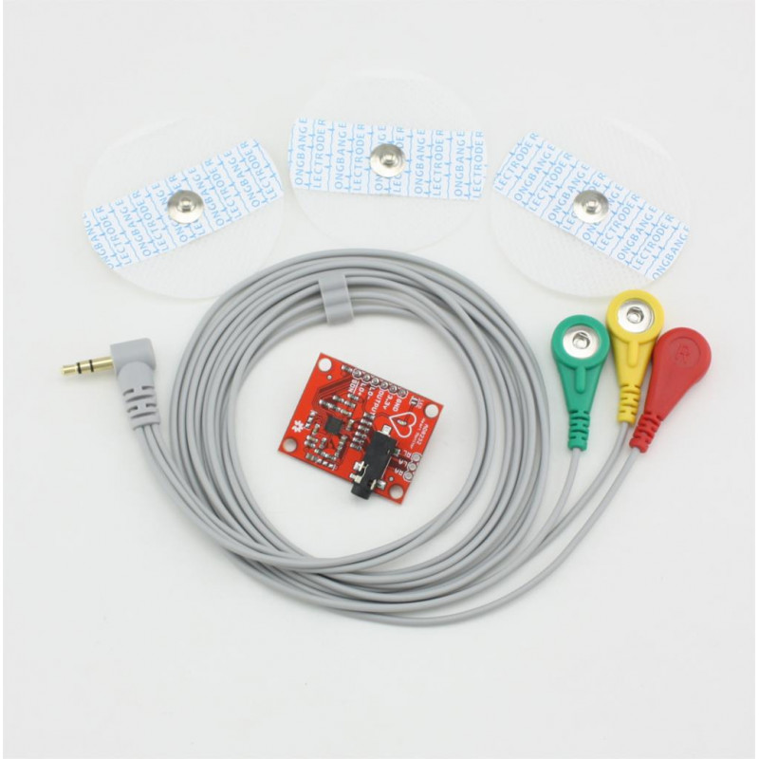

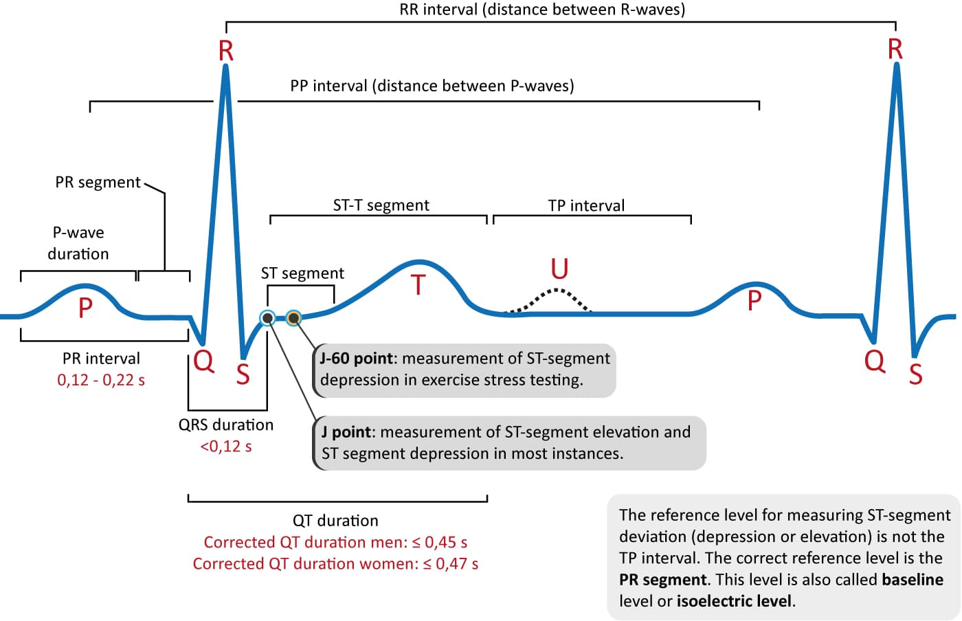





The proposed secure heart monitoring system - Block diagram:
ECG sensor AD8232 attached to the body senses the subject’s heartbeat
Data captured by Arduino UNO and ECG data displayed
Two devices securely connected wirelessly (Socket programming used)
Data transferred from device ‘A’ to device ‘B’ wirelessly
Data pushed into a .txt file
Data

Slide 7
Heart rate sensing:
ECG sensor AD8232 attached to the body senses the subject’s heartbeat
Data captured by Arduino UNO and ECG data displayed

Slide 8
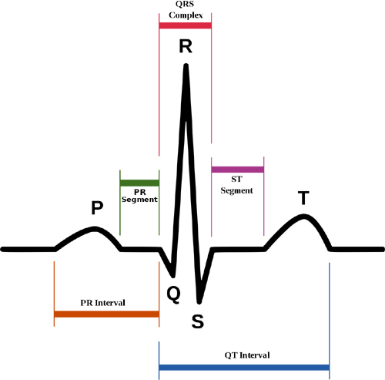
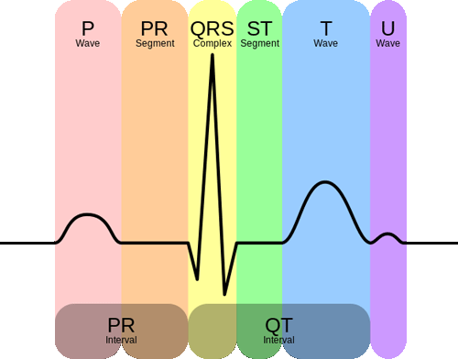
Electro-Cardio-Graph
Each interval in an ECG signal has an optimal value range, and deviation from that might be linked to a particular disease. Here are the main parts of an ECG signal.
P wave - It is the trailing wave on the left of the QRS complex.
QRS complex - It is an impulse generated by ventricular contraction.
T wave - It is a leading wave right to the QRS complex.
U wave - It is not always observed due to its low peak value.
We can diagnose a lot of cardiac diseases and irregularities. For example:
Irregular heartbeat or absence of P-wave: Atrial Fibrillation
Resting Heart Rate of more than 100: Tachyarrhythmia
Tachyarrhythmia and delta wave: Wolf-Parkinson-White or WPW syndrome
Sawtooth P wave: Atrial flutter
Depression of ST-segment: it might indicate Ischemia
Elevation of ST-segment: it might indicate myocardial Infarction

Slide 9
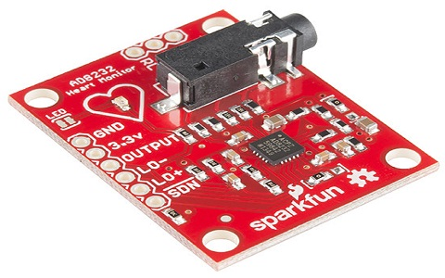
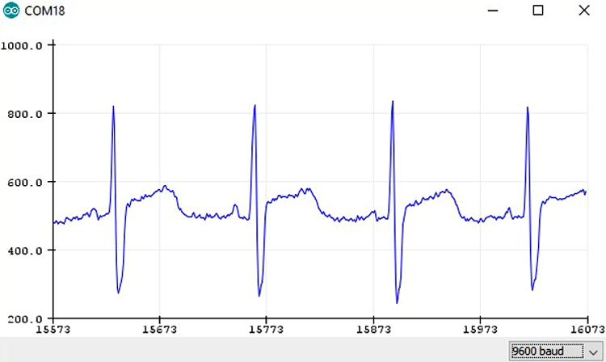
AD8232 ECG Sensor
The AD8232 ECG sensor is a commercial board used to calculate the electrical movement of the human heart. The output of this is an analog reading.
The working principle of the ECG sensor is like an operational amplifier to help in getting a clear signal from the intervals.
The main purpose of this chip is to amplify, extract as well as filter biopotential signals which are small in noisy conditions like those formed due to motion.

Slide 10
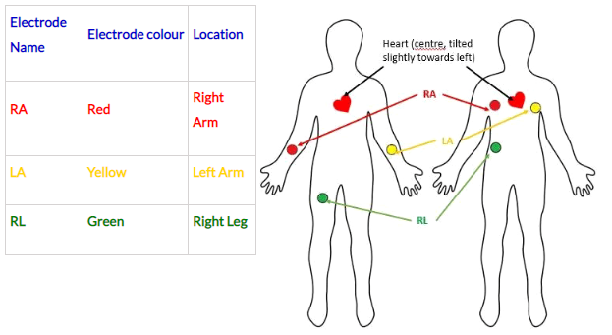
Heart rate measurement from ECG graph
The sensor neither analyzes the ECG, nor checks the presence of the P or T waves, nor will it measure the heartbeat by itself. The calculations must be fed in by us.
Heart rate = No. of R peaks in 1 minute. This means that it would take 1 entire minute for a single heart rate value to appear.

Slide 11
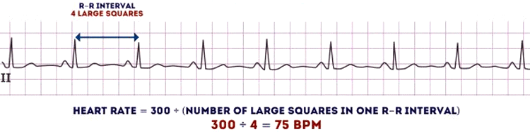
Heart rate measurement from ECG graph
This method is medically incorrect because this assumes that each R-R interval throughout the entire 1 minute is the same. However, this is not the case.
For an average healthy human, the time taken by 1 entire heartbeat is around 800-850 ms (65-75 beats per minute). This might change depending on whether the person is resting or working. Whatever the case might be, the heartbeat intervals do not vary much for a person. But for a person suffering from Atrial fibrillation or Arrhythmia, the heartbeat varies significantly throughout the ECG, despite the average heartbeat appearing to be normal. The parameter to identify this is called Heart Rate Variability.

Slide 12
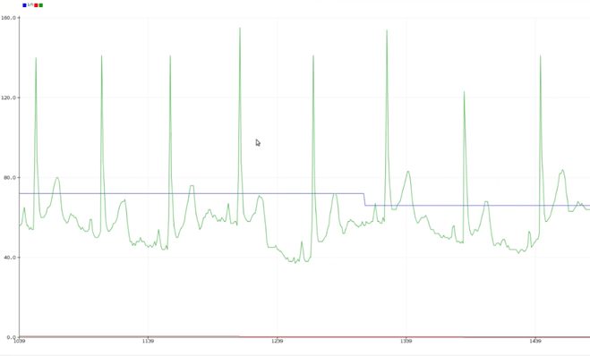
Heart rate measurement from ECG graph
The green signal indicates a slightly modified ECG while the blue signal indicates the approximated heartbeat.
HRV is not visible much on the plotter because it will generally be around -1 to 1 milli secs for a normal human, while the ECG value and heart rate will be around 70. Hence, HRV is seen as a red line on the serial plotter.
On the serial monitor, the values are displayed as follows: heartrate, HRV, ECG value.

Slide 13

Heart rate measurement from ECG graph
Calculating Heart Rate Variability (HRV) using AD8232 ECG Sensor:
$$HRV= \frac{HR}{60} −RR interval$$
So, for calculating HRV, we need HR first. But 1 minute is too long. Hence, we use a window of 10 seconds to calculate both parameters.
$$HR=RR peaks in 10 seconds ×6$$
$$HRV= \frac{HR}{60} −RR interval$$

Slide 14
Socket programming:
Socket programming is a way of connecting two nodes on a network to communicate with each other.
One socket(node) listens on a particular port at an IP, while the other socket reaches out to the other to form a connection.
The server forms the listener socket while the client reaches out to the server. They are the real backbones behind web browsing.
A network socket is a software structure within a network node of a computer network that serves as an endpoint for sending and receiving data across the network.
Two devices securely connected wirelessly (Socket programming used)

Slide 15
Socket programming:
Socket programming is started by importing the socket library and making a simple socket.
import socket
s = socket.socket(socket.AF_INET, socket.SOCK_STREAM)
Here we made a socket instance and passed two parameters. The first parameter is AF_INET (refers to the address-family IPv4) and the second one is SOCK_STREAM (it means connection-oriented TCP protocol).
Two devices securely connected wirelessly (Socket programming used)

Slide 16
Socket programming:
Server:
A server has a bind() method which binds it to a specific IP and port so that it can listen to incoming requests on that IP and port.
A server has a listen() method which puts the server into listening mode. This allows the server to listen to incoming connections.
A server has an accept() and close() method. The accept method initiates a connection with the client and the close method closes the connection with the client.
After that, we bound our server to the specified port. Passing an empty string means that the server can listen to incoming connections from other computers as well.
Client:
We need something with which a server can interact.
Two devices securely connected wirelessly (Socket programming used)

Slide 17
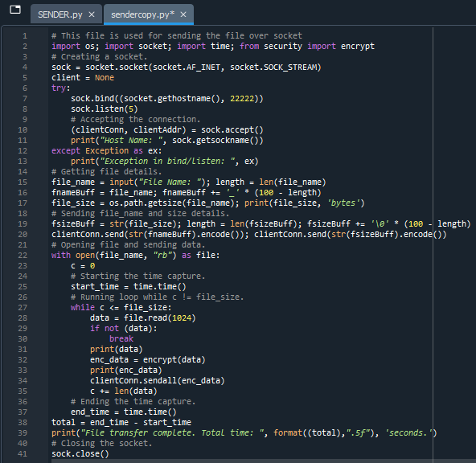
Sender program:
Data transferred from device ‘A’ to device ‘B’ wirelessly
Data

Slide 18
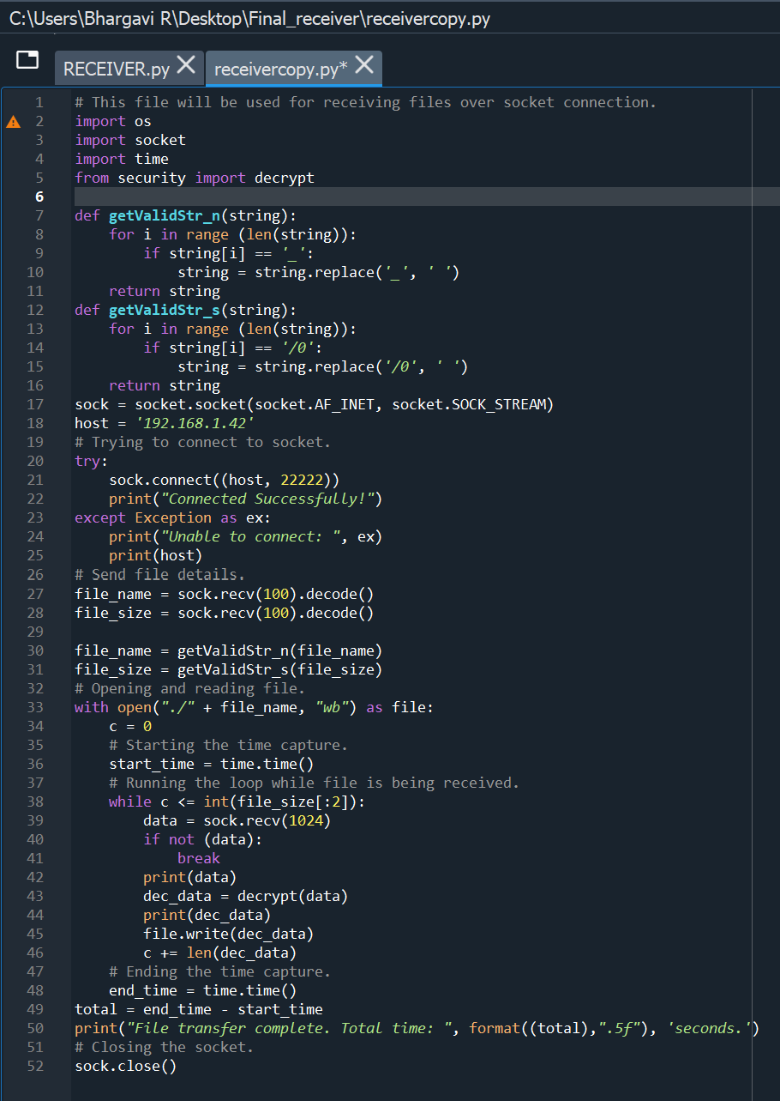
Receiver program:
Data transferred from device ‘A’ to device ‘B’ wirelessly
Data

Slide 19
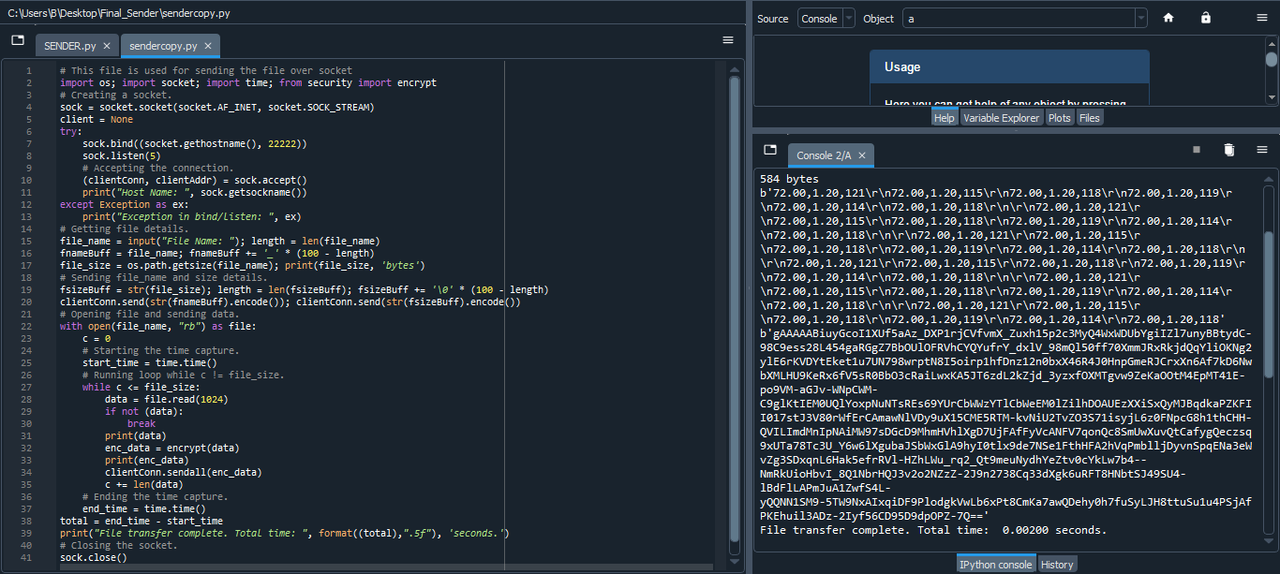
Outputs:

Slide 20
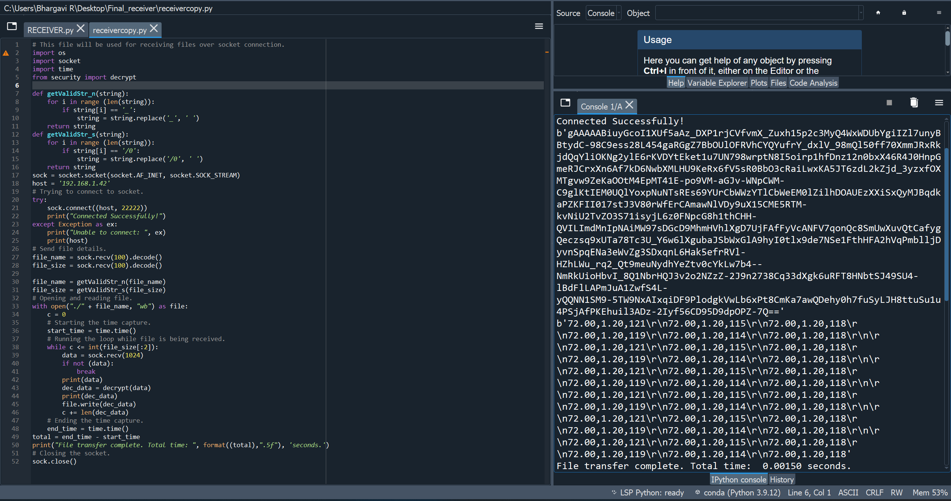
Outputs:

Slide 21
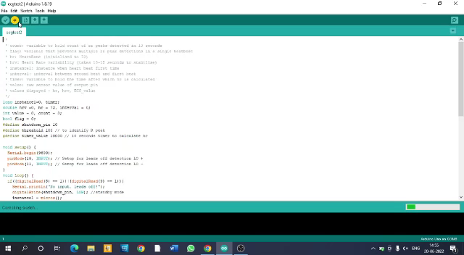
Working

Slide 22
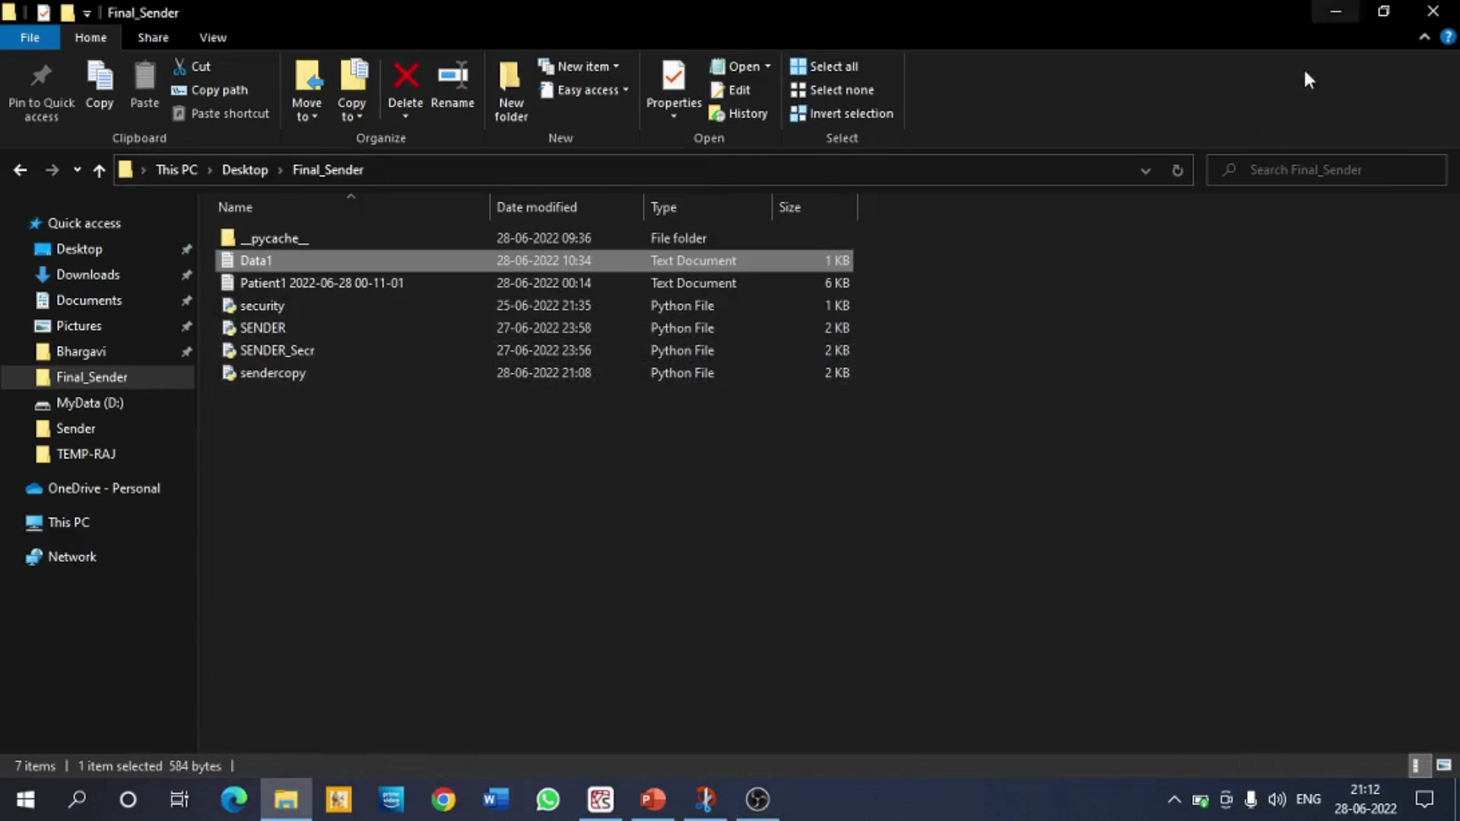
Working

Slide 23
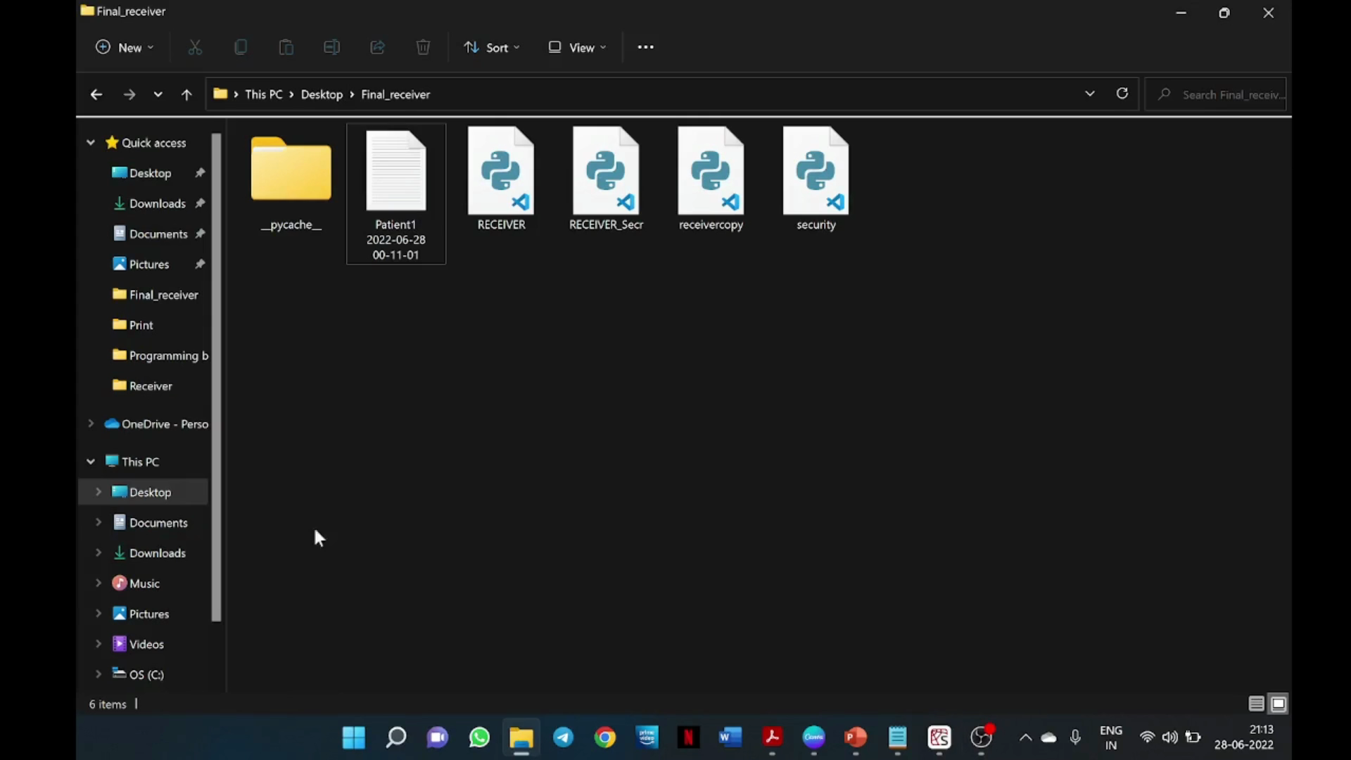
Working

Slide 24
References
https://ieeexplore.ieee.org/document/7779108
https://how2electronics.com/ecg-monitoring-with-ad8232-ecg-sensor-arduino/
https://www.youtube.com/watch?v=01y_Vu_sAQU
https://www.geeksforgeeks.org/socket-programming-python/

